Slide 1
Fitness Finder
01
02
03
Overview
Fitness Finder is a app that combines all Fitness related items in one place.
Made By
Jacqueline Kolze & Savannah Niemeyer
What it does
This app eliminates the need for multiple fitness apps, it creates a all in one experience for the user.

Slide 2
Target Audience
Runners!
Goals:
Create an all-in-one app for users to be able to:
Find groups or running partners in via Meetup API
Search for parks to run based on location or popularity using Google Maps API
Find upcoming events such as a 5K or half marathon using Eventbrite API
Save their favorite groups, places, or events in their own personal database

Slide 3
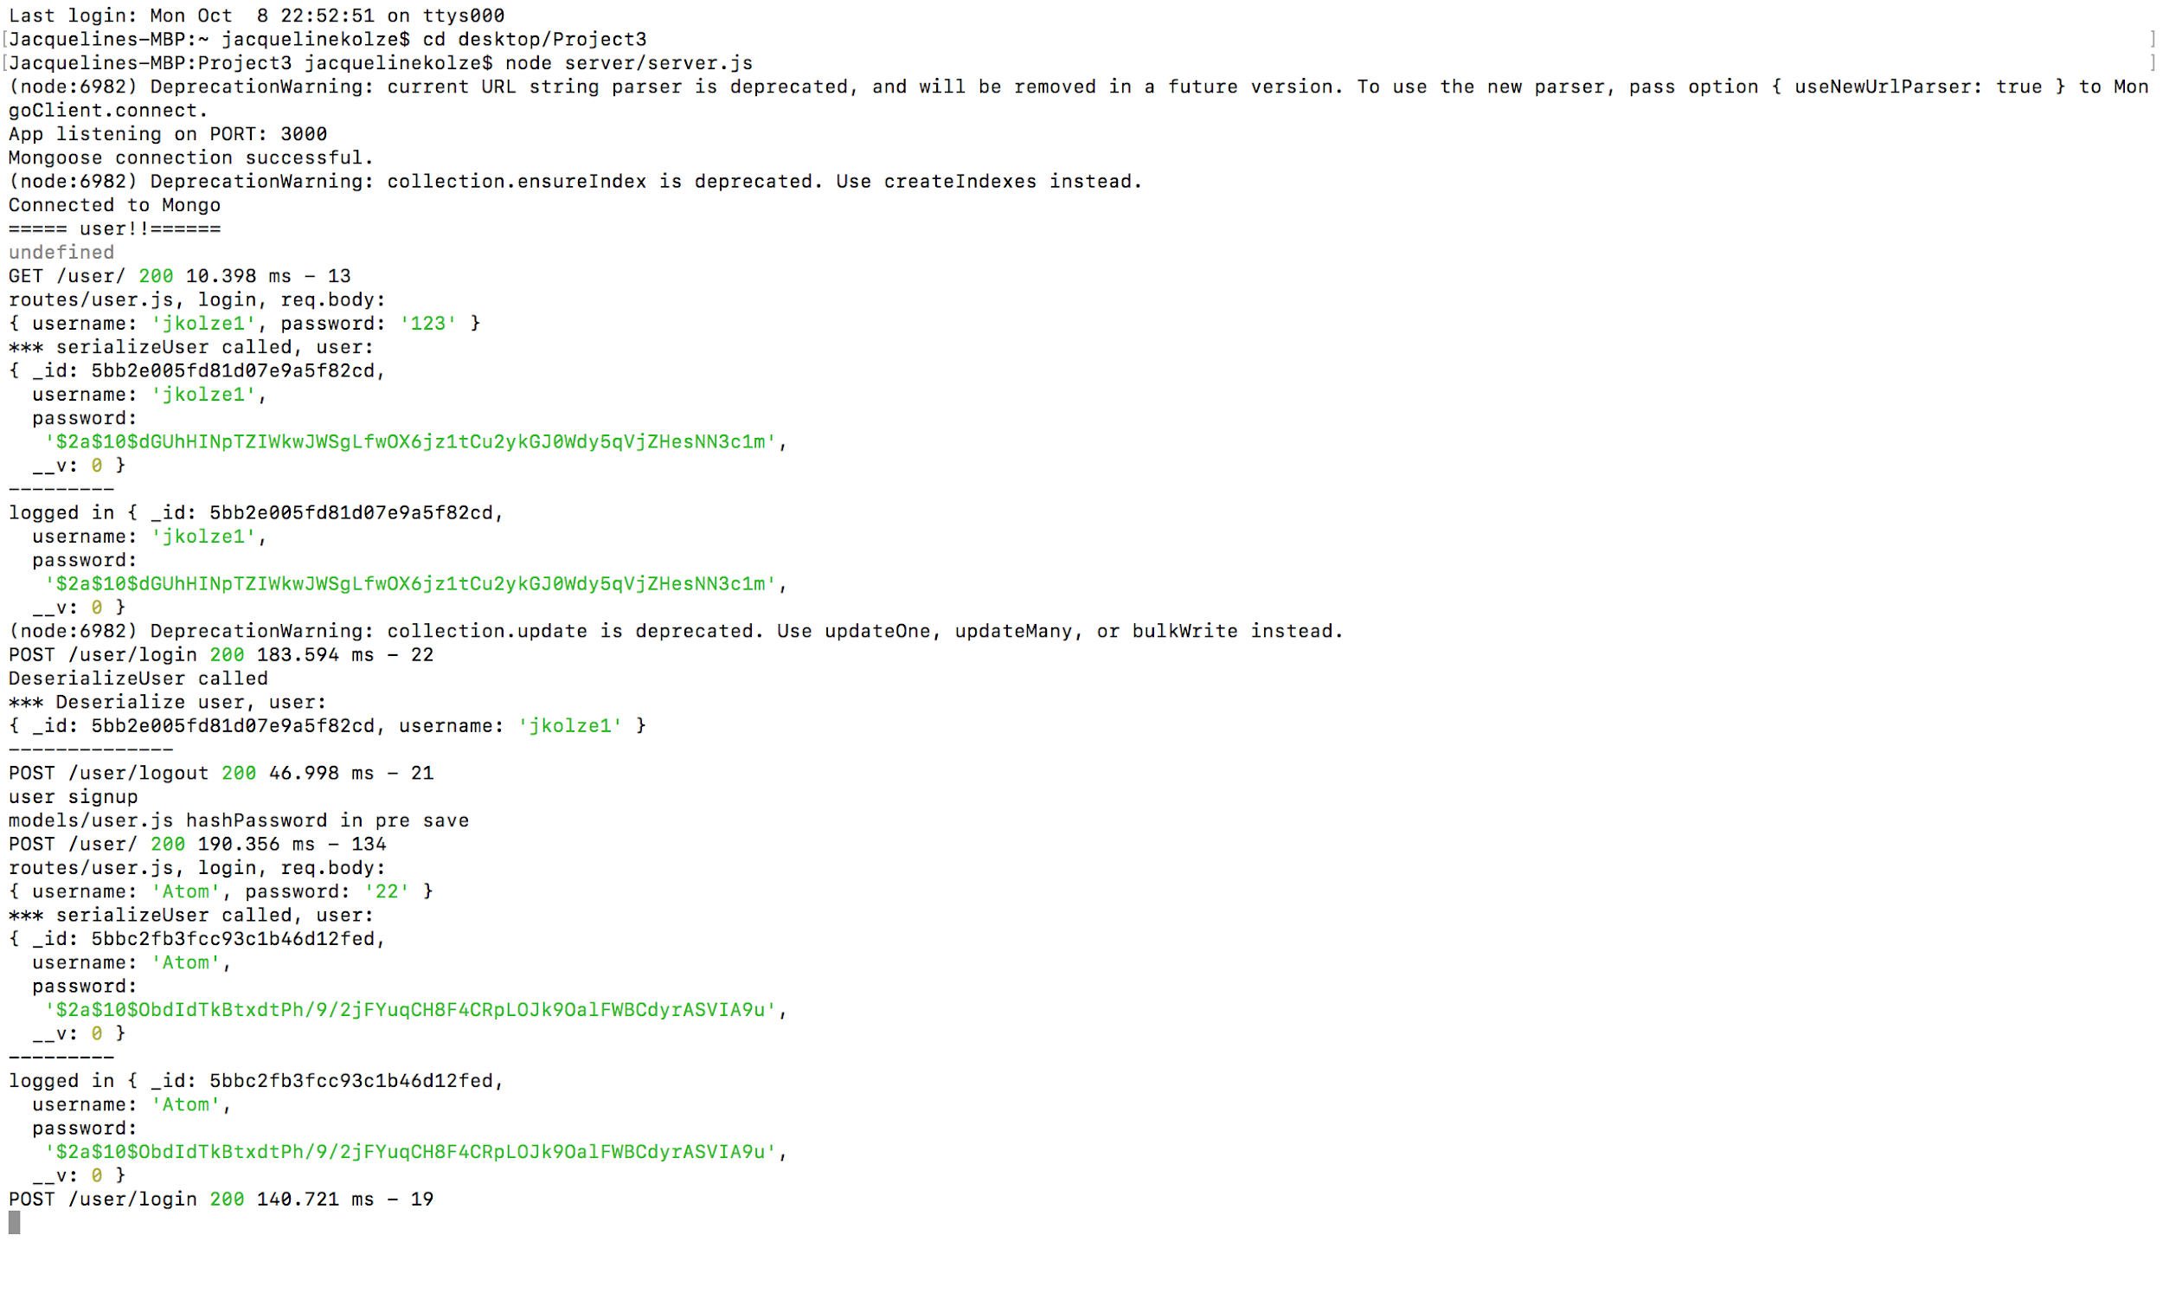
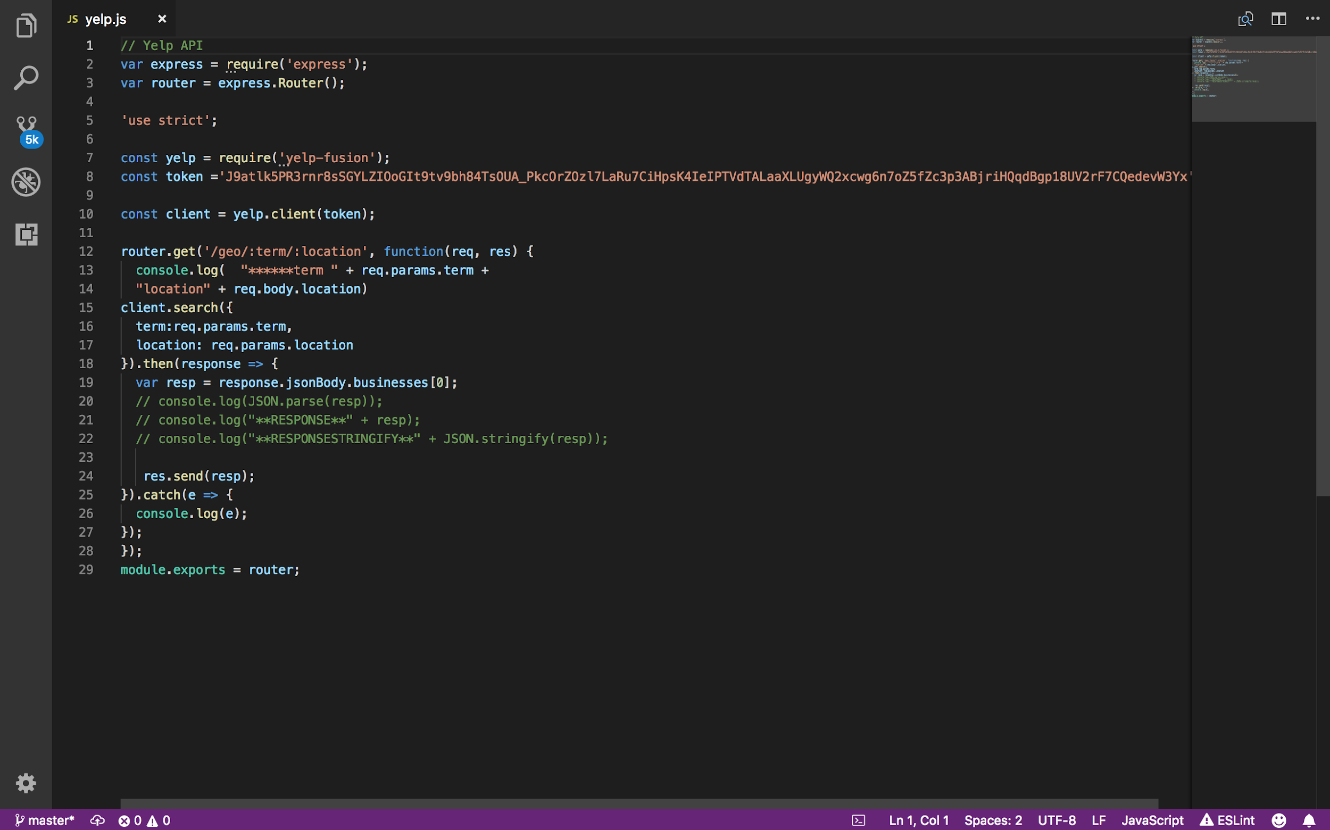
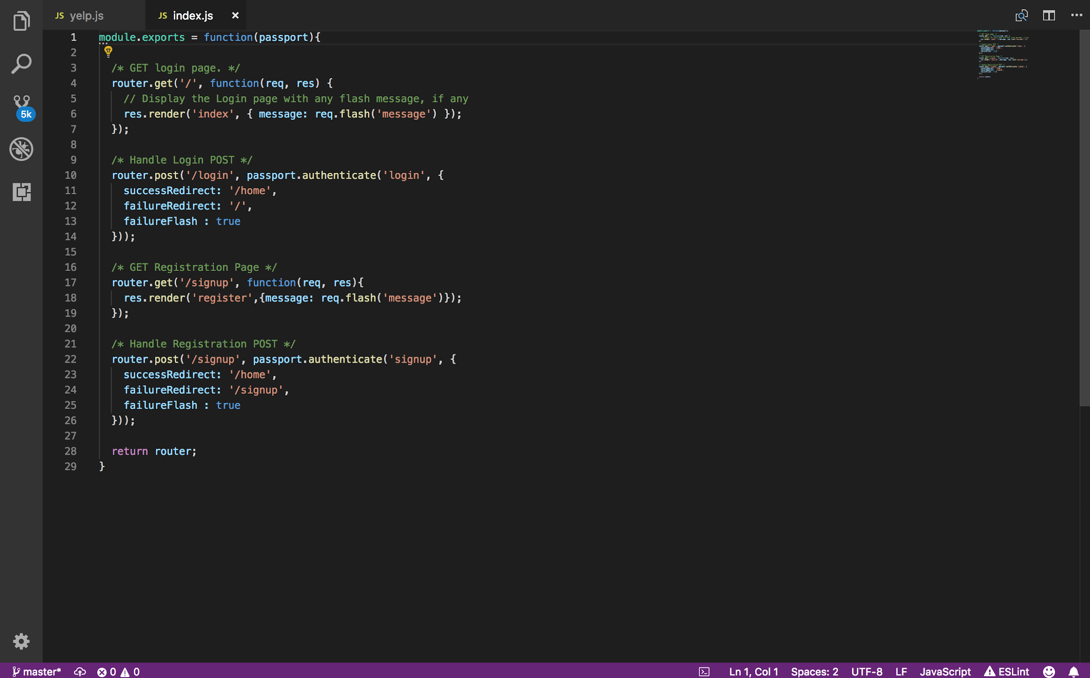
Backend
Tools used
For the login/Sign up component I used Passport for authentication, mongo DB to store user info, and Brycpt to hash out sensitive materials.
API’s Used
I used Yelp-fusion, Google Maps, and Active API. Yelp and Google Maps are for finding new trails and parks, While the Active API is for all health related things.

Slide 4
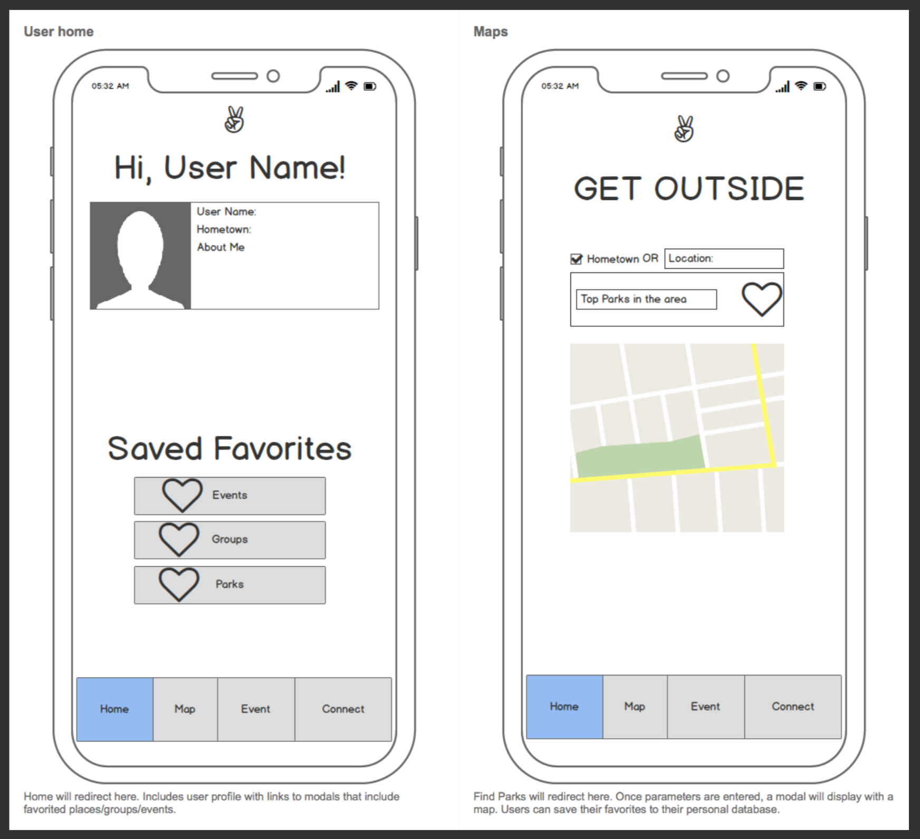
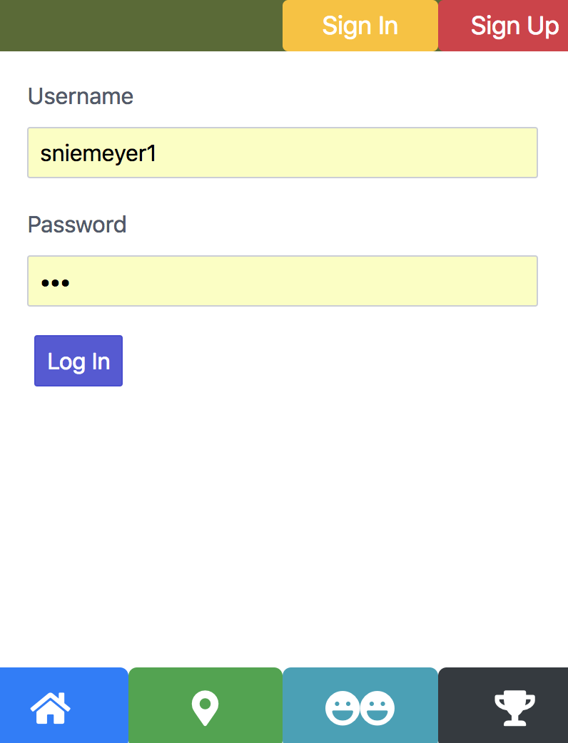
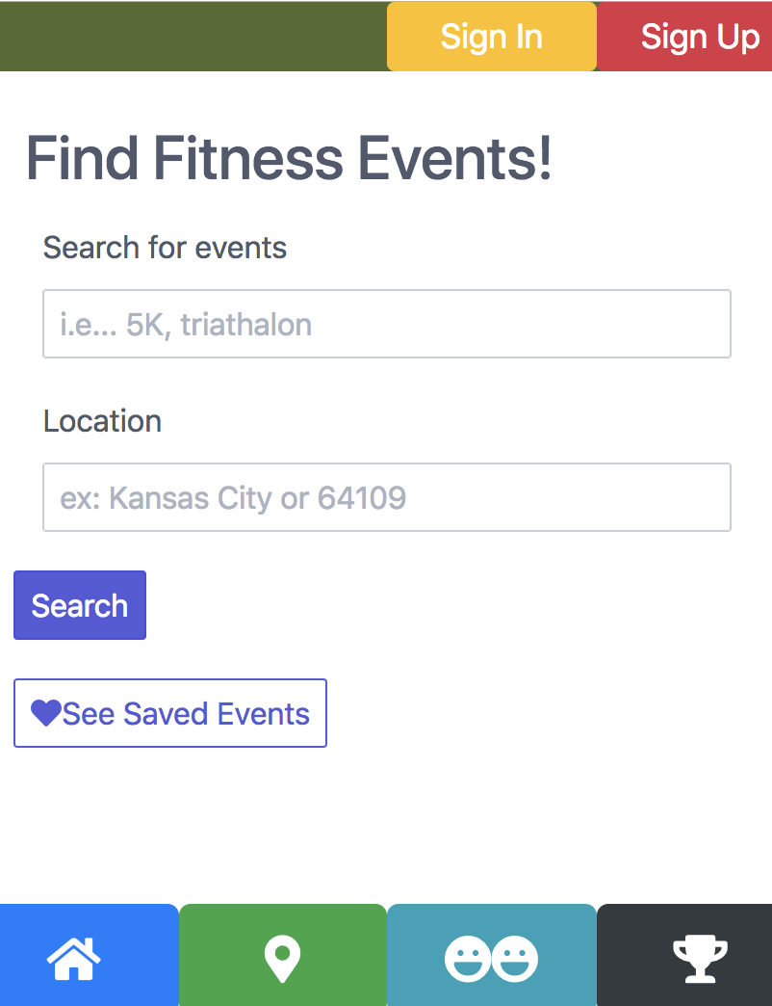
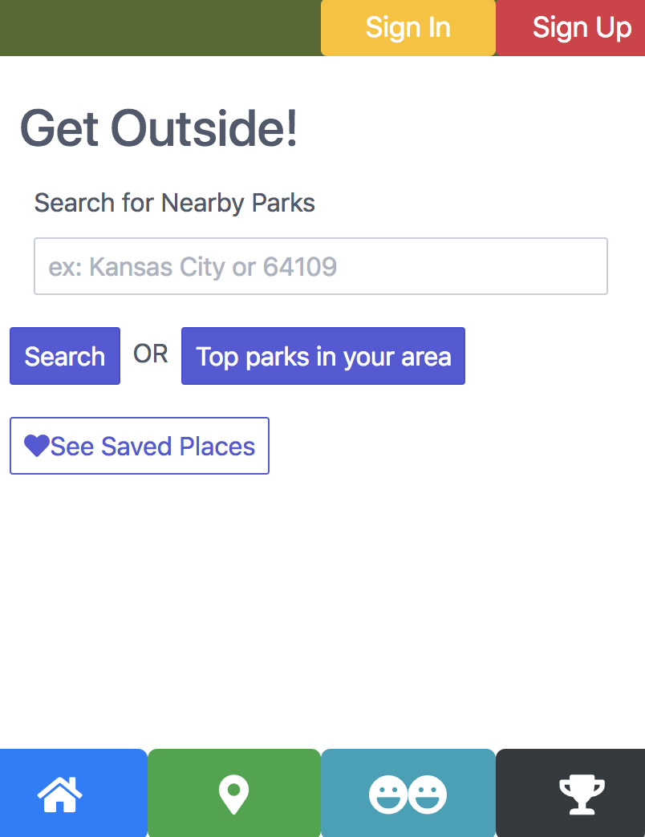
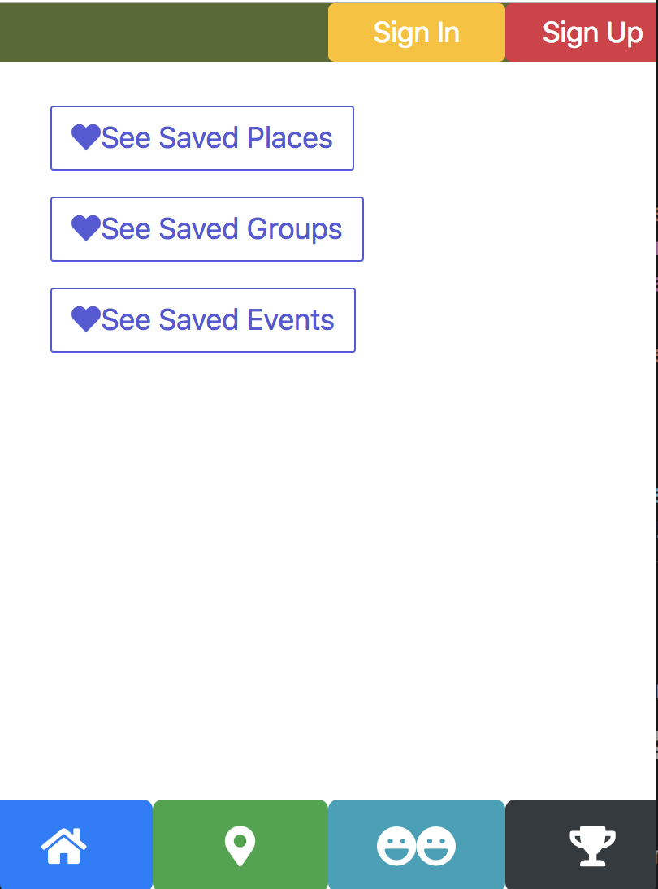
Front End
Tools Used
React.js
Bootstrap
Reactstrap

Slide 5
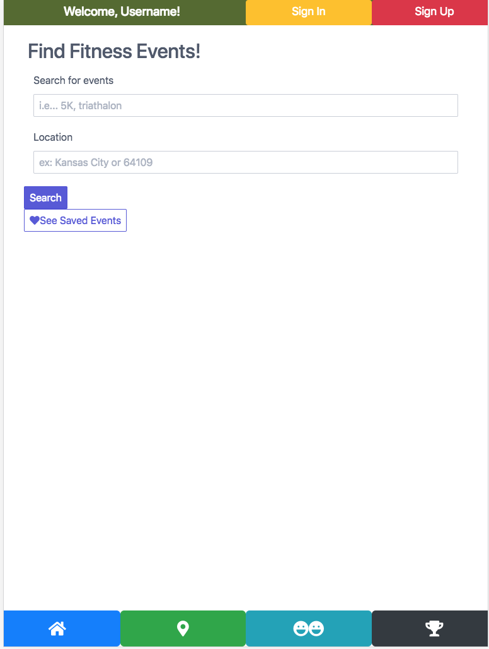
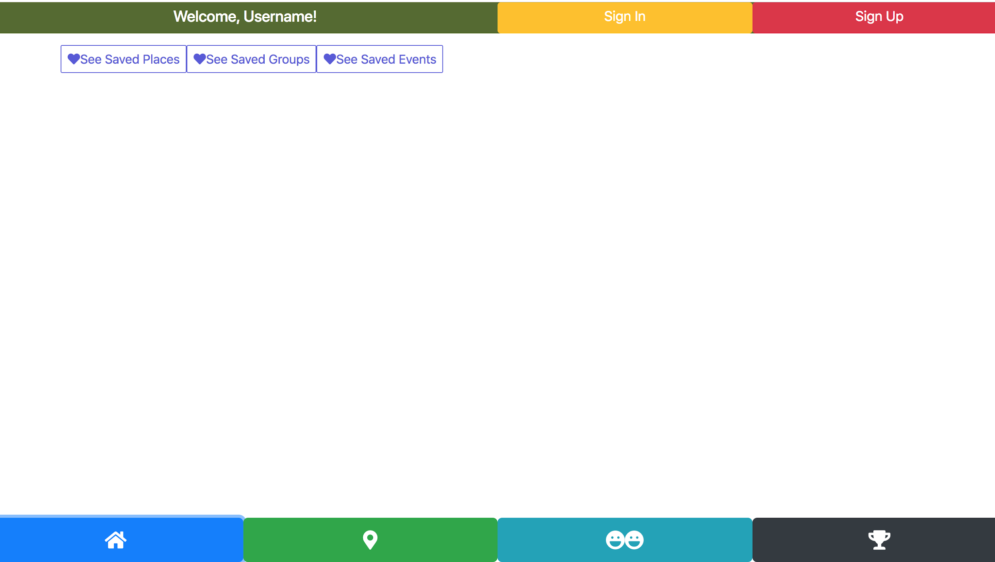
Layout

Slide 6
API’s
-Google Maps
-Yelp Fusion
-Meetups API
- Event Bright
-Originally we tried to use the Active API, that did not work out though, this is because it had not been updated since 2015.

Slide 7
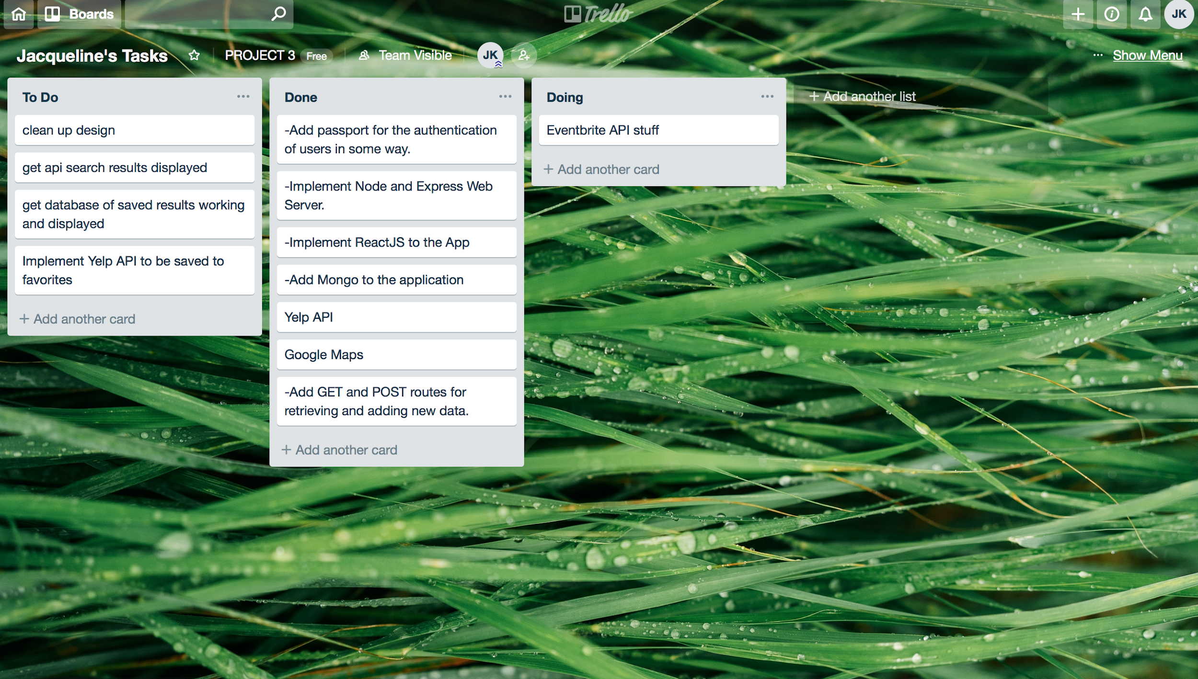
Trello Board!

Slide 8
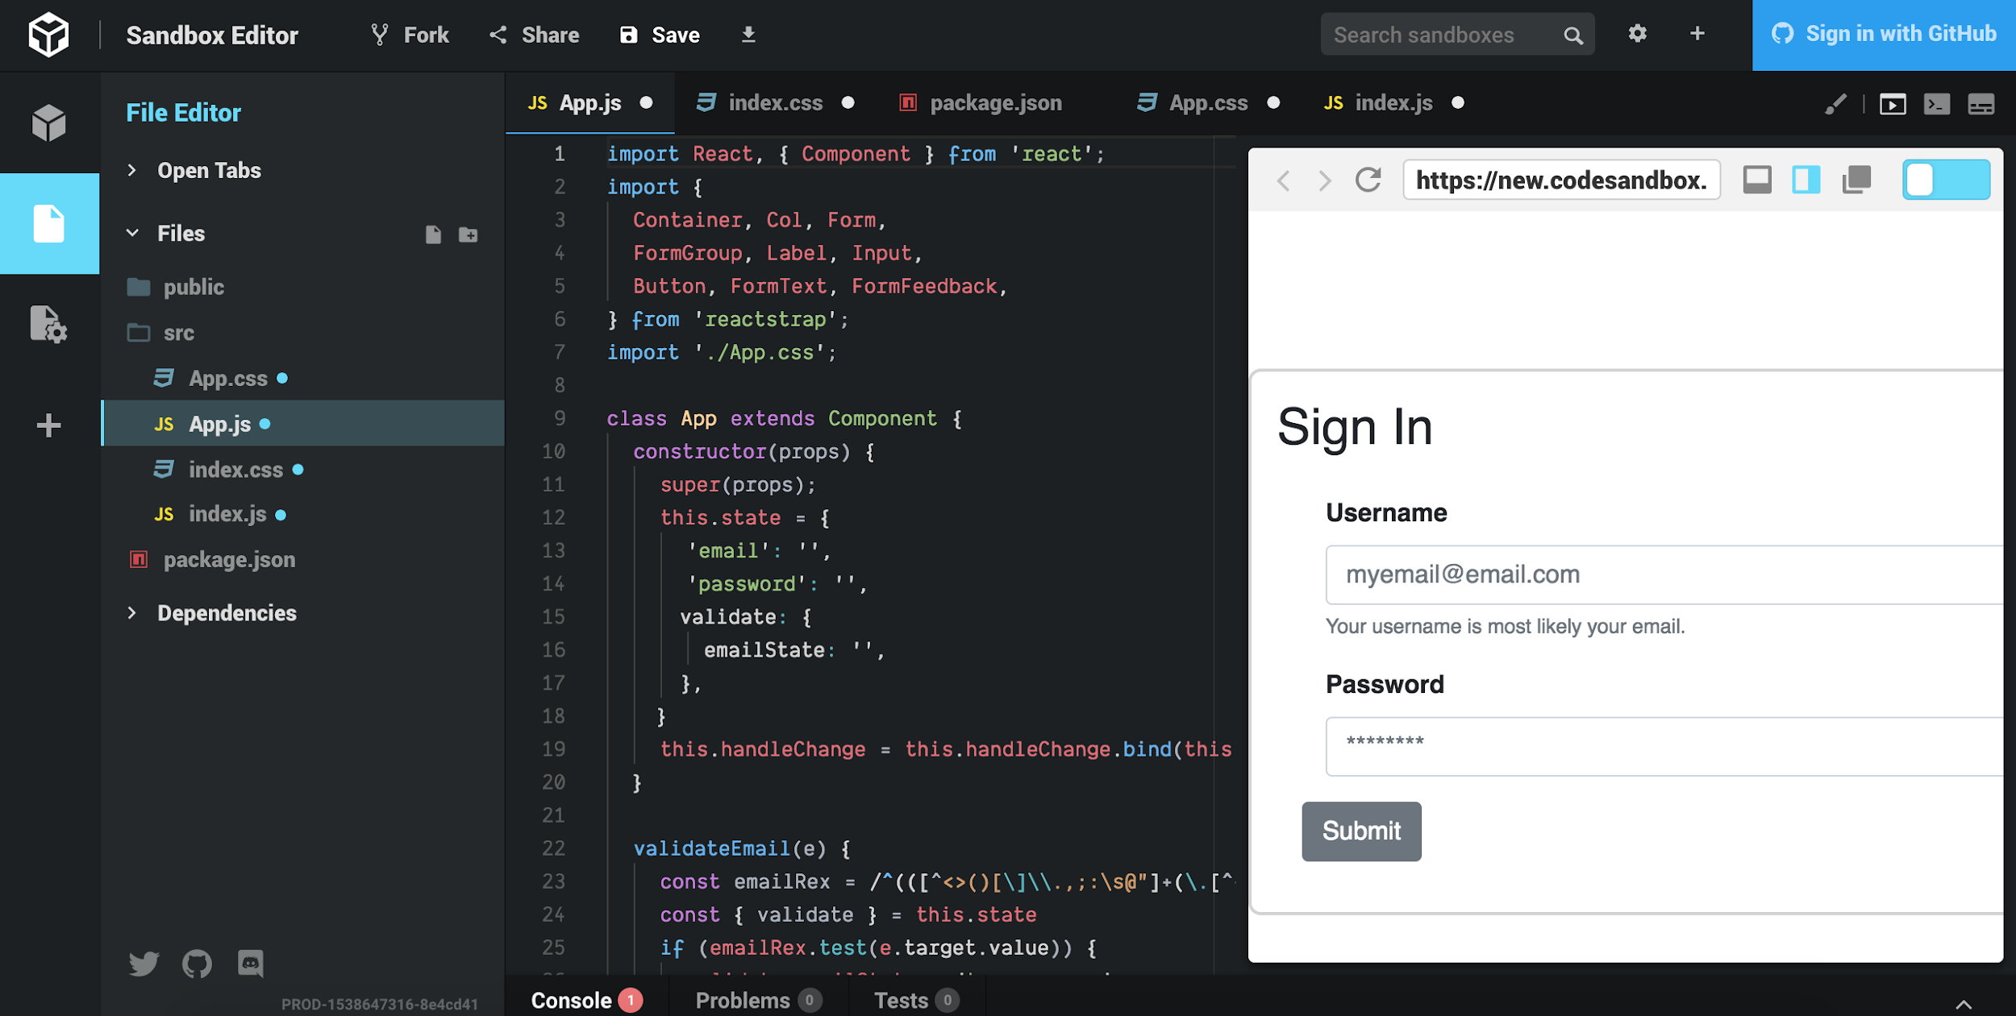
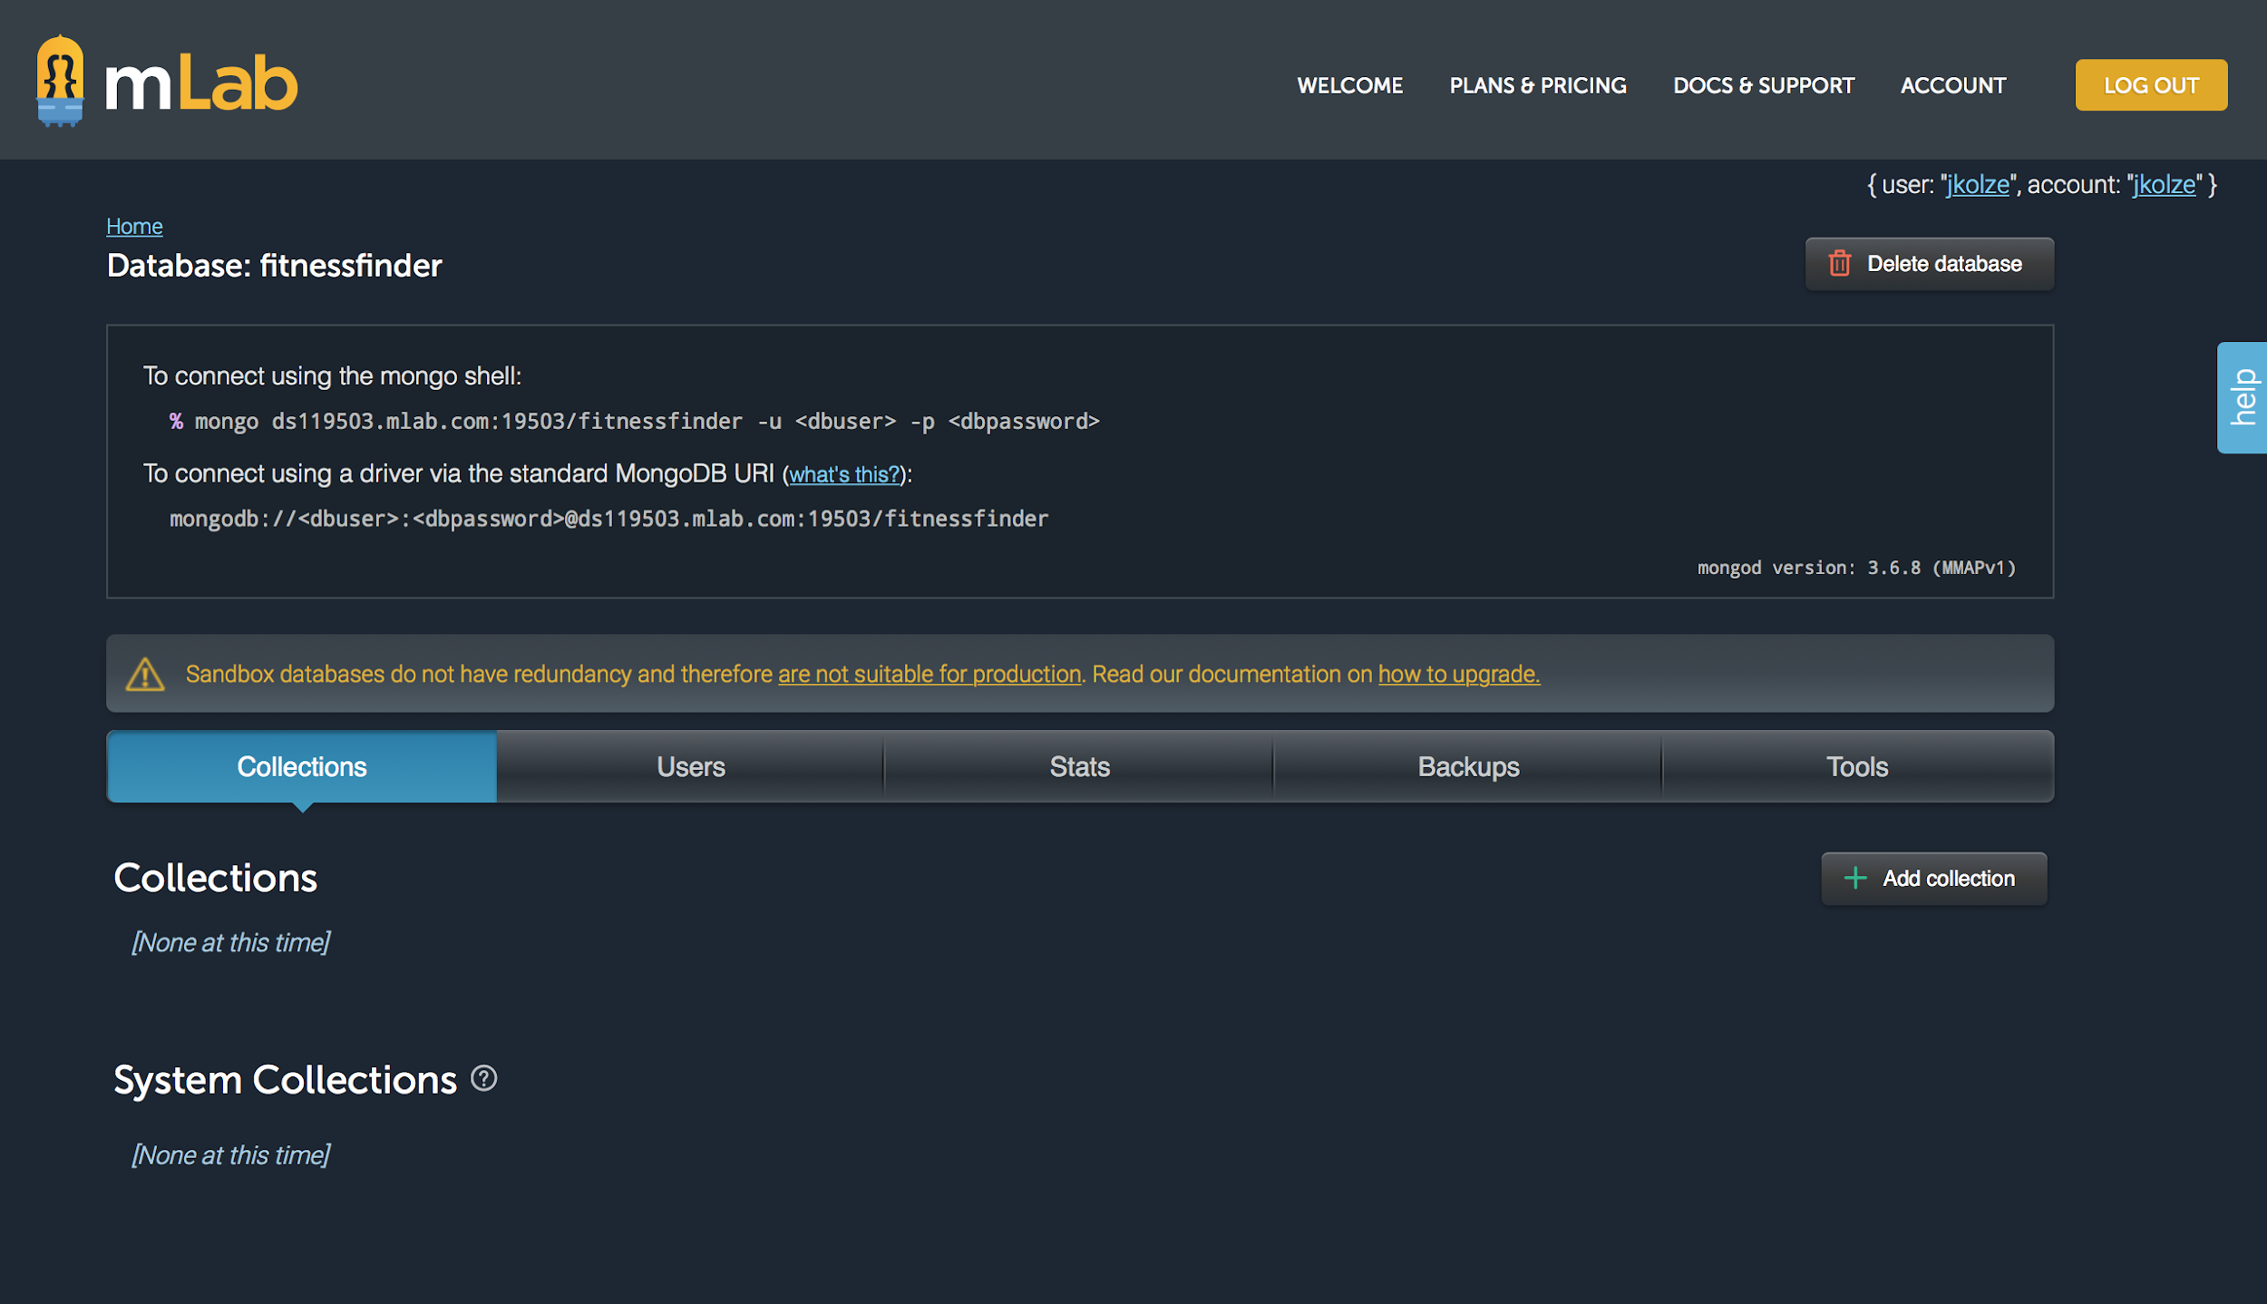
Other tech we used

